Slide 1
Naïve Bayes Classifier
Kunal Malhotra
kunal.malhotra1@ibm.com
@kunal_forever

Slide 2
Classification Problems with Naïve Bayes
Two step process
Training
Data
Model
Build the model – this is the training process where we estimate model parameters
Train
Use the model – here, we predict the output class given the inputs
Input to be classified
Predict
Prediction

Slide 3

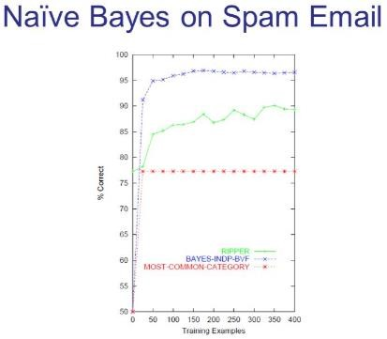
When to use Naïve Bayes: Three Scenarios
You have come up with a neat solution to a ML problem. Your manager wants you to do a quick demo to your CEO in the next couple of hours.
You are assigned a classification problem similar to spam filtering. Your manager says: We need this feature in our next release, a less accurate model is okay.
You have come up with a sophisticated deep learning based model. You submitted this for review and you are asked to benchmark your results against standard approaches

Slide 4
Naïve Bayes Classifier
A simple classifier model that is:
Based on the Bayes theorem
Uses Supervised Learning
Easy to build
Faster to train, compared to the other models
Often used as a baseline classifier for benchmarking

Slide 5
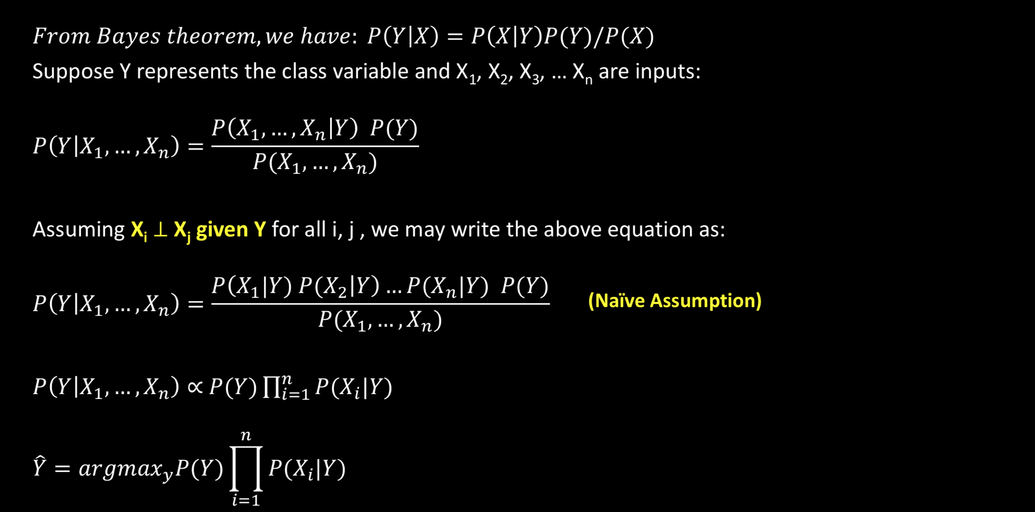
Foundation: Bayes Theorem

Slide 6
What is Naïve about Naïve Bayes?
In many applications, treating one element in the input (X_{i}) independent of every other element in
the input (X_{j} for all j) and also ignoring word order is quite a strong assumption
Why?
The sentence: “day great is today a” is a jumbled form of “Today is a great day”. This suggests that the ordering of words is important for us to perform a semantic interpretation. NB classifier treats each word as independent and hence ignores the order, which in many cases will not hold.
Take a selfie of yourself, the picture looks great! What if we randomly shift the pixels around throughout the image? Though all pixels are still present in the modified image, their order is severely altered.
But:
Despite the Naïve assumption, NB Classifier still works and produces accurate results for a number of applications!
Consider the problem of search using keywords. Does the word order matter?

Slide 7
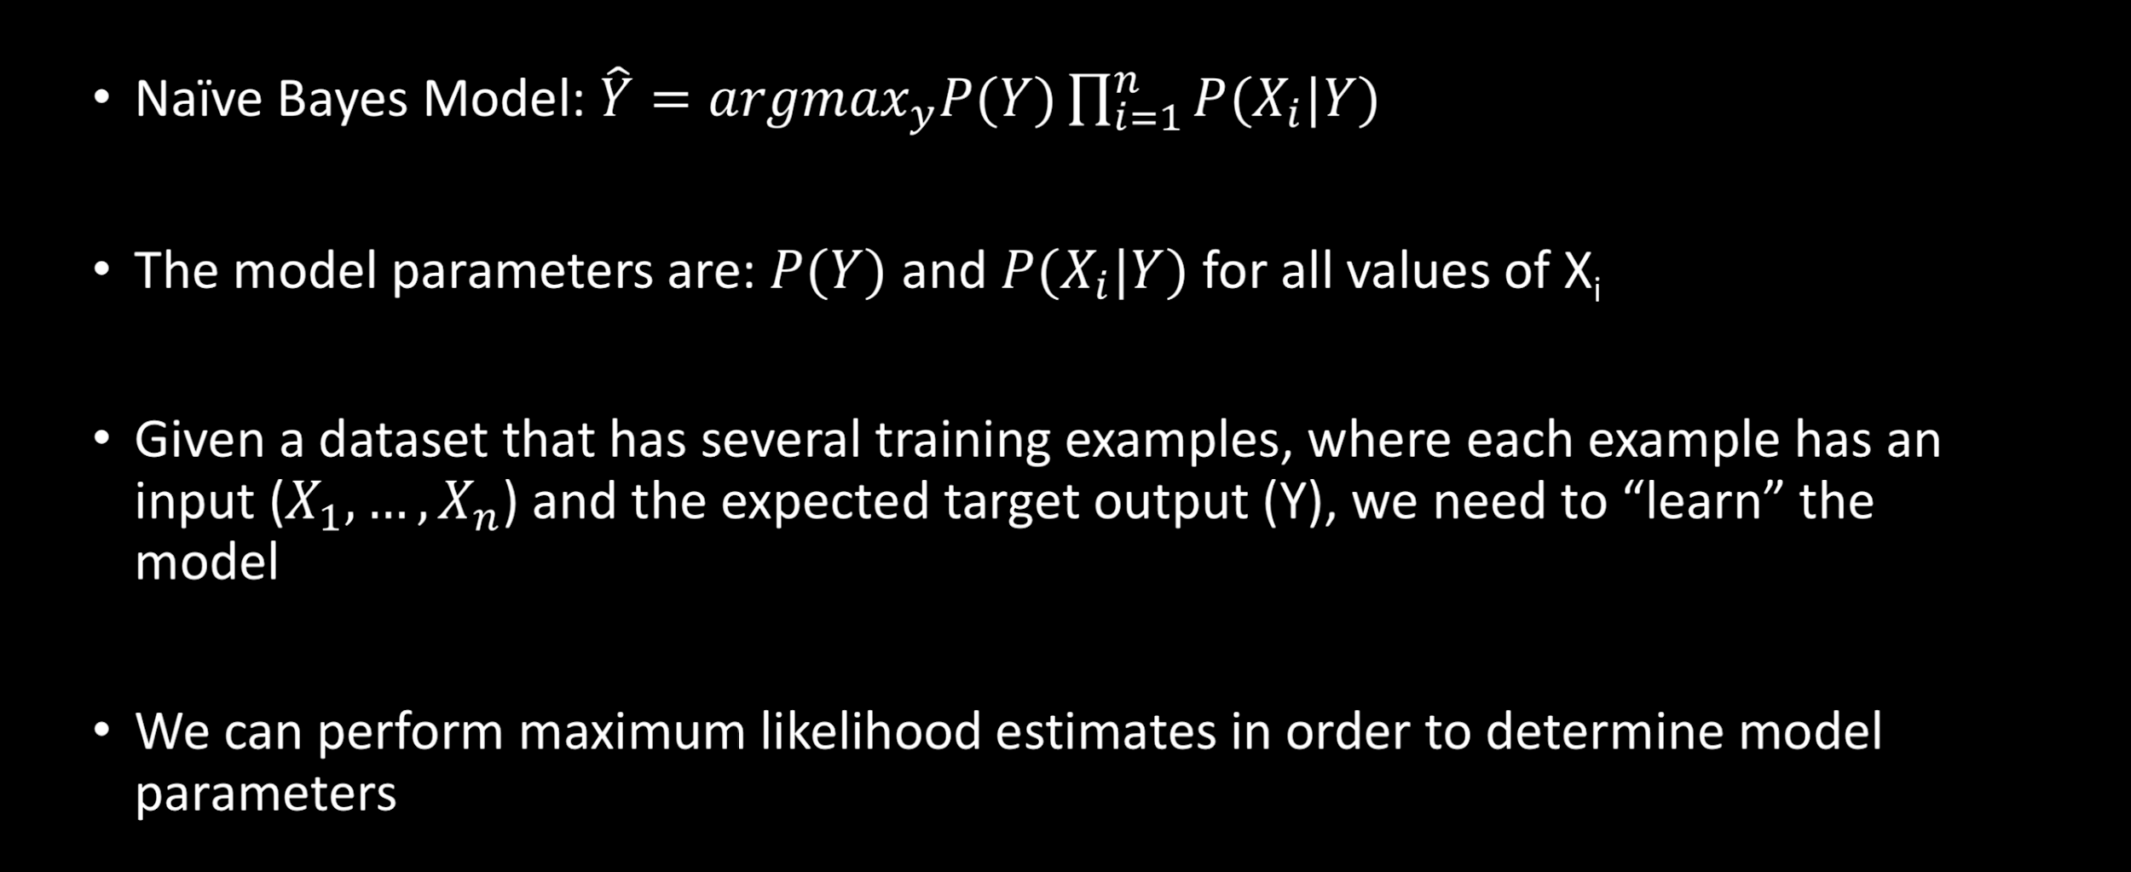
Estimating the model parameters

Slide 8
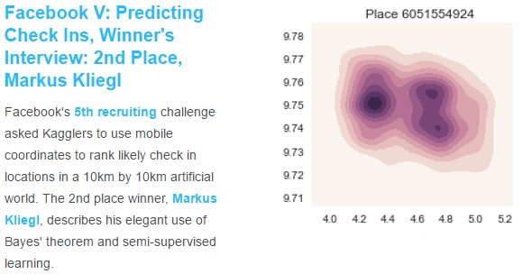
Naïve Bayes Classifier for the real world use cases

Slide 9
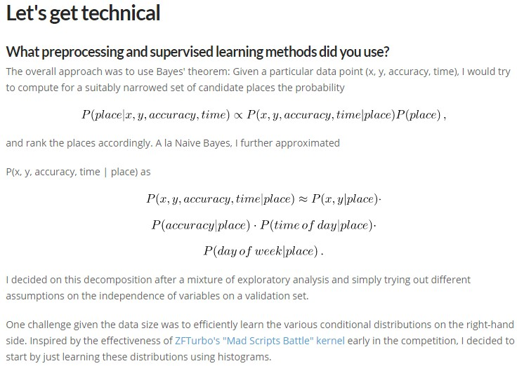
Naïve Bayes Case Study Kaggle

Slide 10
Document Classification With Naïve Bayes
Document (or text in our discussion today) classification assigns a class label to the given document. Formally:
Given the input as document d and a set of classes 𝐶 = {𝑐₁, 𝑐₂, … , 𝑐_{𝑛}}, predict a class 𝑐 ∈ 𝐶
Example:
Gmail categorizes the incoming mails in to Primary, Social, Promotions, Junk – we can define:
𝐶 = {𝑃𝑟𝑖𝑚𝑎𝑟𝑦, 𝑆𝑜𝑐𝑖𝑎𝑙, 𝑃𝑟𝑜𝑚𝑜𝑡𝑖𝑜𝑛𝑠, 𝐽𝑢𝑛𝑘}
Assign a class label 𝑐 ∈ 𝐶 for every incoming mail d
The term document could be a plain text or even a compound multimedia
document. We use the term document to refer to any entity that can be classified.

Slide 11
Can we build rule based models to do this?
For instance, in email categorization, one may apply a set of if-then-else rules and determine the class of input mail
With well written rules, in general, one can get high precision but often low recall
Drafting a set of comprehensive rules is difficult and expensive as they need expert knowledge
Example: Suppose I receive a mail from flipkart, should that be classified as a promotion or primary?
It depends!

Slide 12
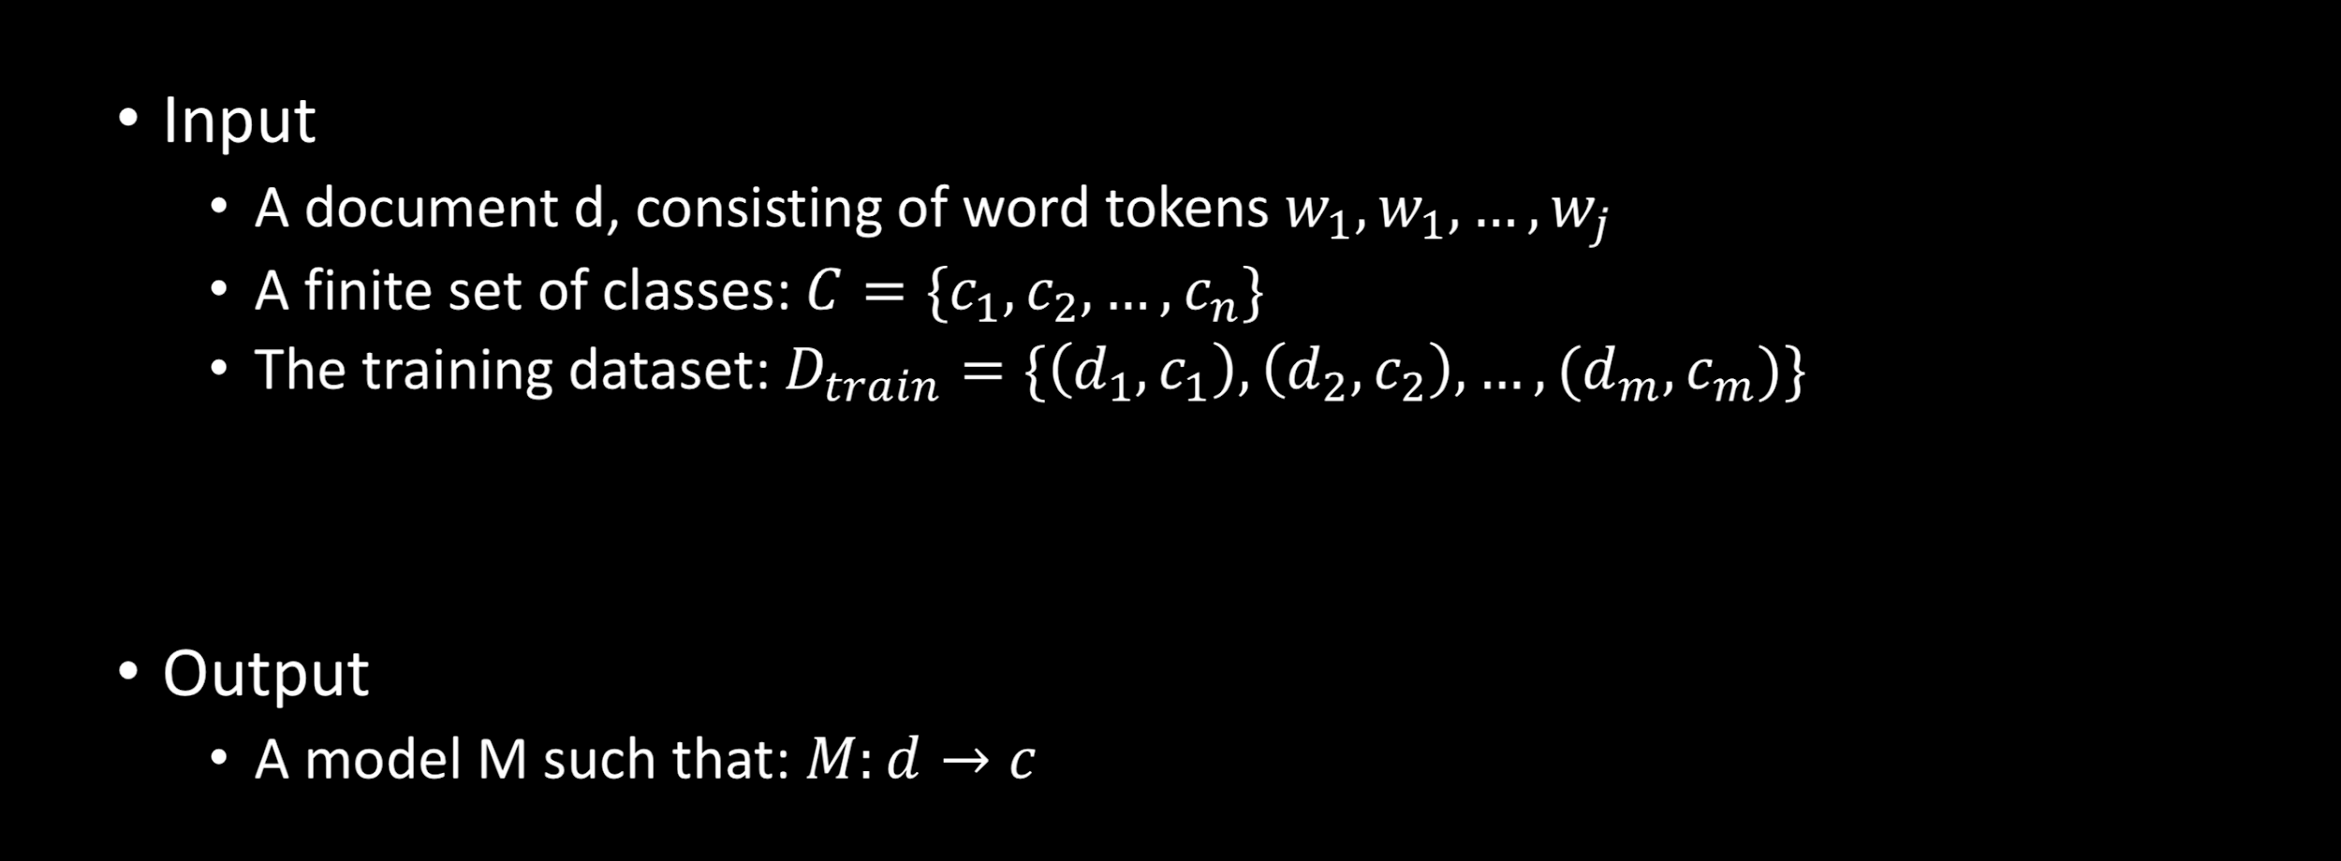
Supervised Machine Learning

Slide 13
Bag of words representation
A document can be considered to be an ordered
sequence of words
Naïve Bayes classifier ignores the word order and correlations and hence we may represent a document d as bag of words or unigrams
In a typical English sentence, there may be many words that are required for grammatical purposes and may not contribute to the classification decision.
We can do some pre-processing and remove such words before sending the document to the classifier

Slide 14
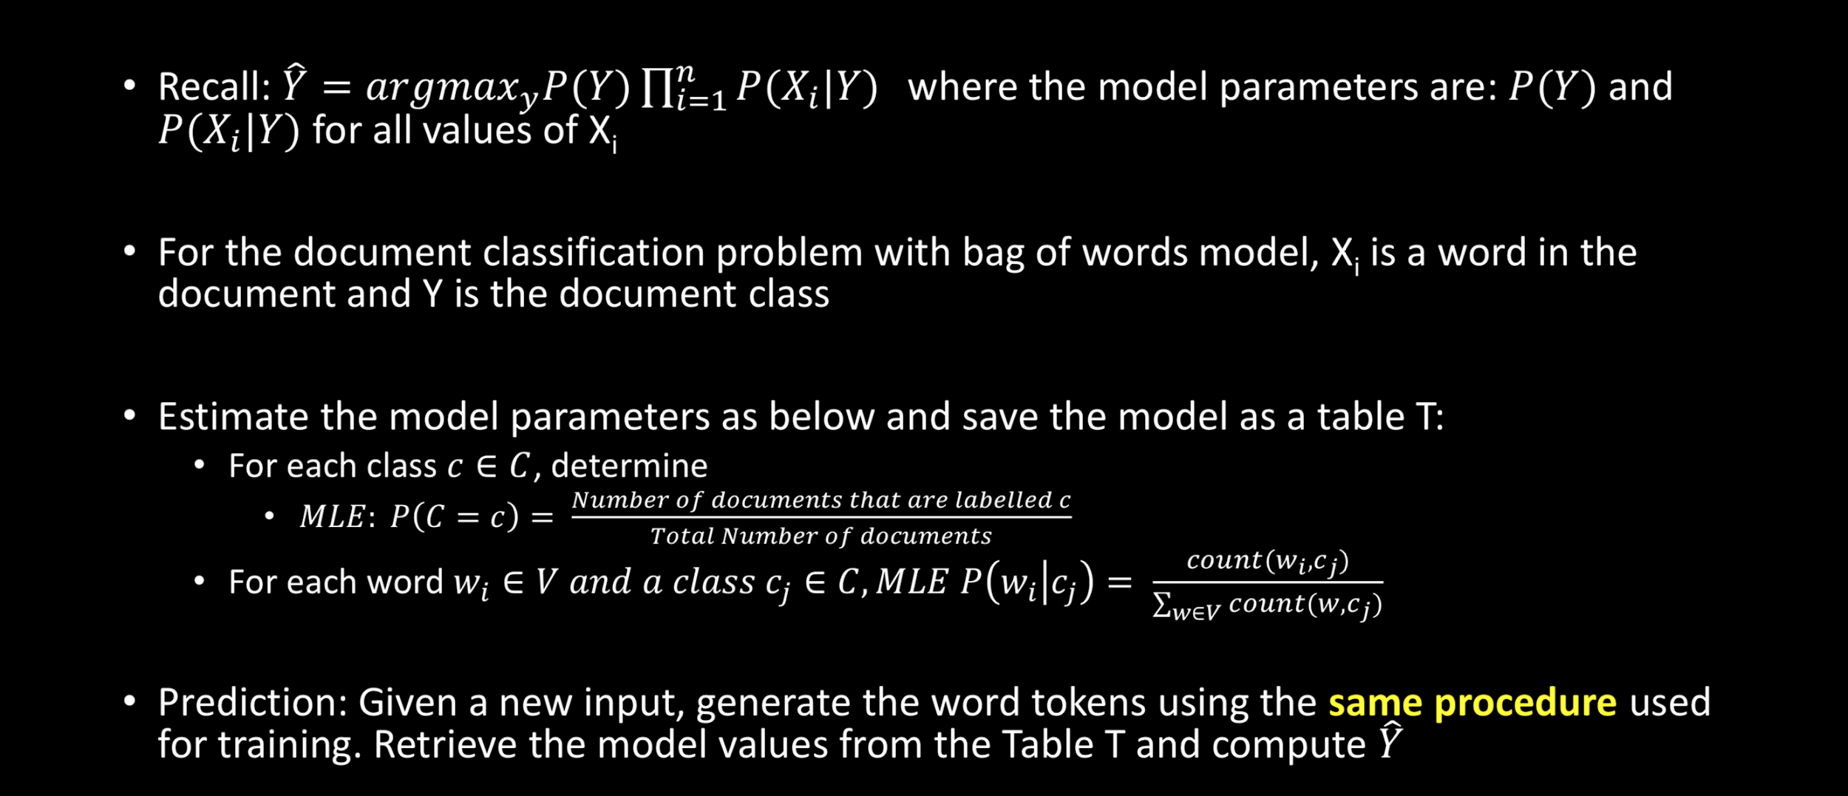
Text Classification with Multinomial Naïve Bayes

Slide 15
Are we done? Not yet ☹
What happens if 𝑐𝑜𝑢𝑛𝑡(𝑤_{𝑖} , 𝑐_{𝑗} ) = 0 ?
This can happen if the new unseen input has a word 𝑤_{𝑖} , that was not encountered in the training data.
Example: The training data contains “I love my Samsung Galaxy Grand 2” but doesn’t have the word, say, “adore”. If the unseen input is: “I adore my Samsung Galaxy Grand 2”, the entire probability computation will be zero!

Slide 16
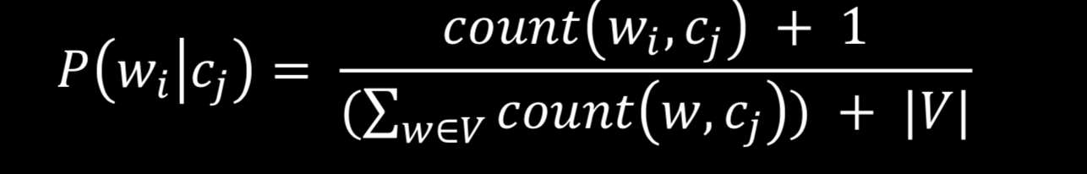
Laplace Smoothing (Add 1)
Assume any word in the vocabulary has occurred at least once
This assumption results in the estimation:
The above ensures that the probabilities don’t go to zero
What happens when you encounter a word that is not in the vocabulary?

Slide 17
Variants of Naïve Bayes
In the previous slides we showed the MLE probability computation to be based on counts of words in each document. This is called the multinomial model.
Multinomial is a natural fit when we solve topic classification kind of problems
E.g. Consider the problem of classifying a given article in to Scientific, Business, Sports.
Sometimes, just the presence or absence of a given word in a document is adequate in order to classify. We may choose a Binarized Naïve Bayes in such cases.
E.g Consider the problem of sentiment analysis. If there is a word “fantastic”, it doesn’t need to be repeated in the same document in order for us to conclude the polarity of the sentiment.
A number of applications may involve features that are real valued. We can use a Gaussian (or
some other) variant for these.

Slide 18
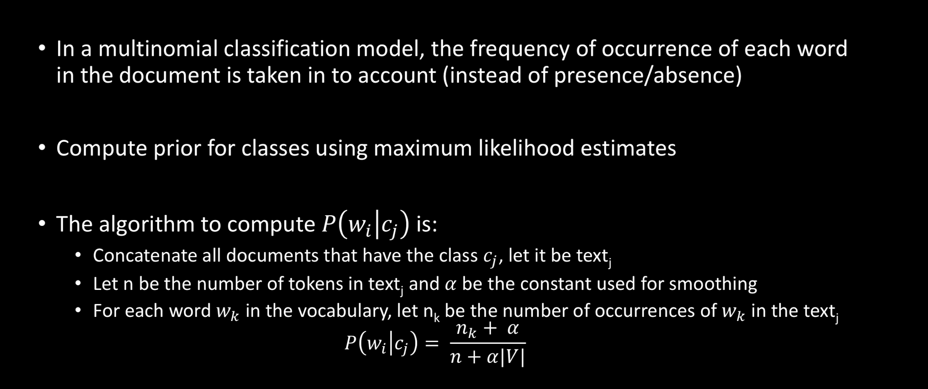
Multinomial Naïve Bayes

Slide 19
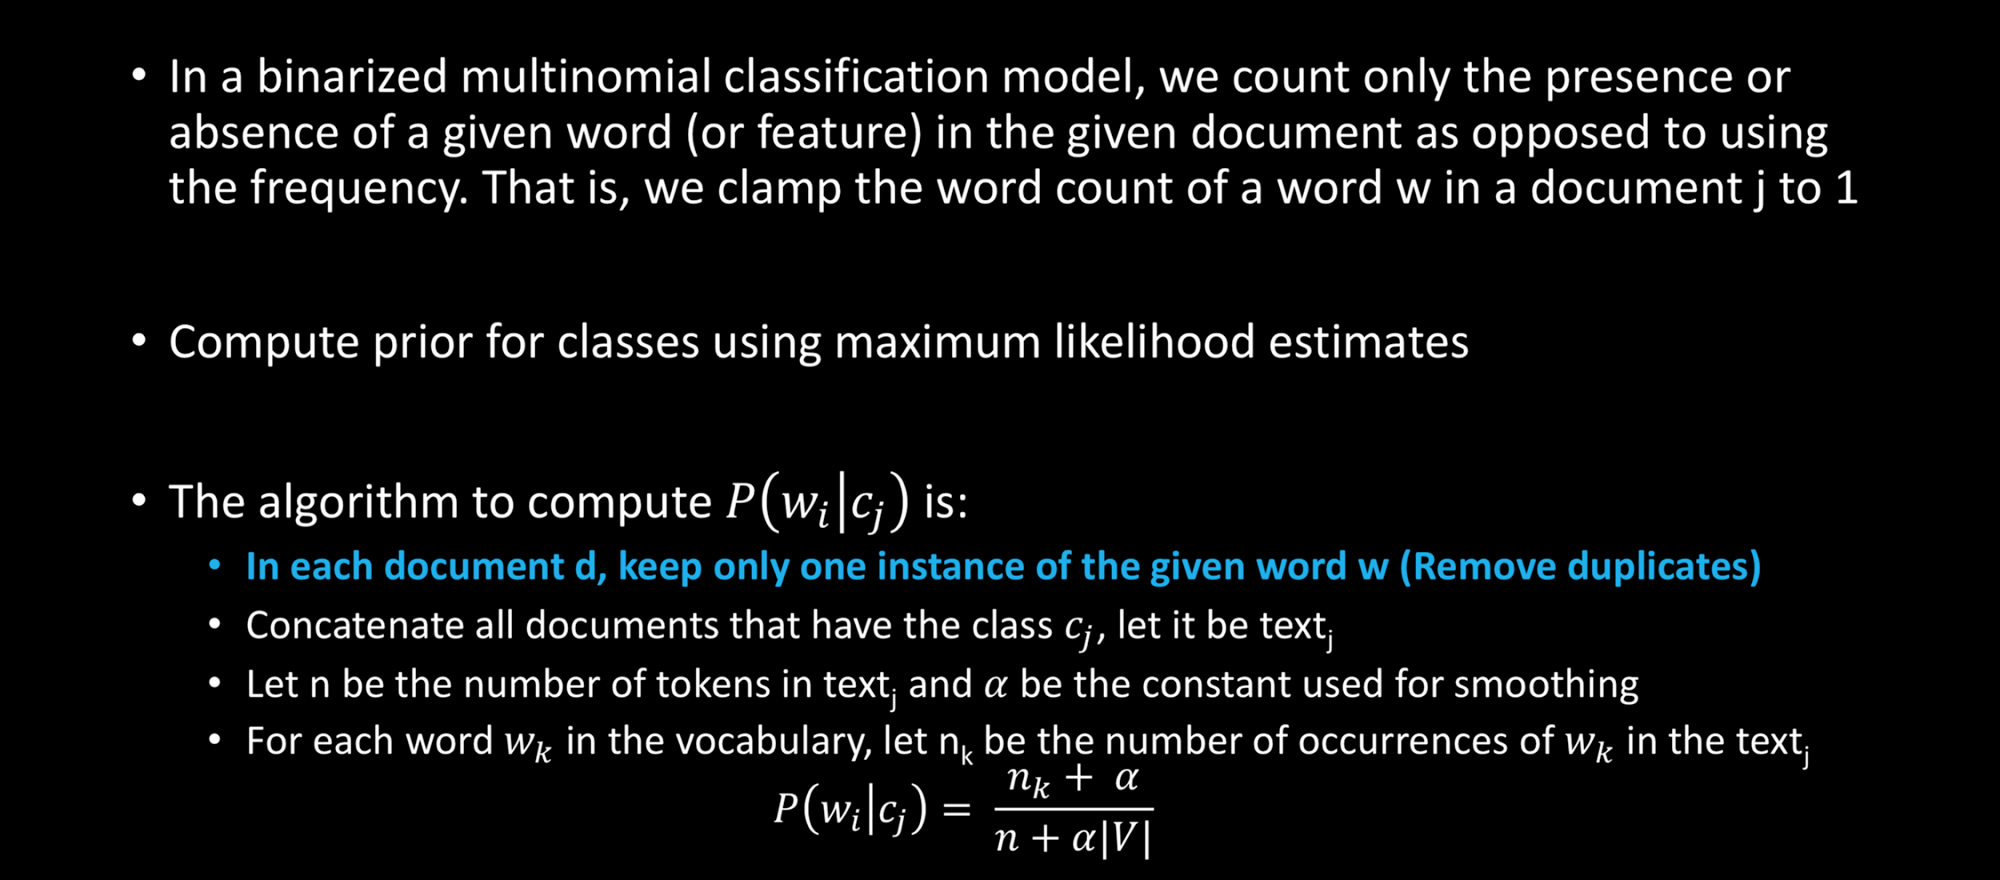
Binarized Multinomial Naïve Bayes

Slide 20
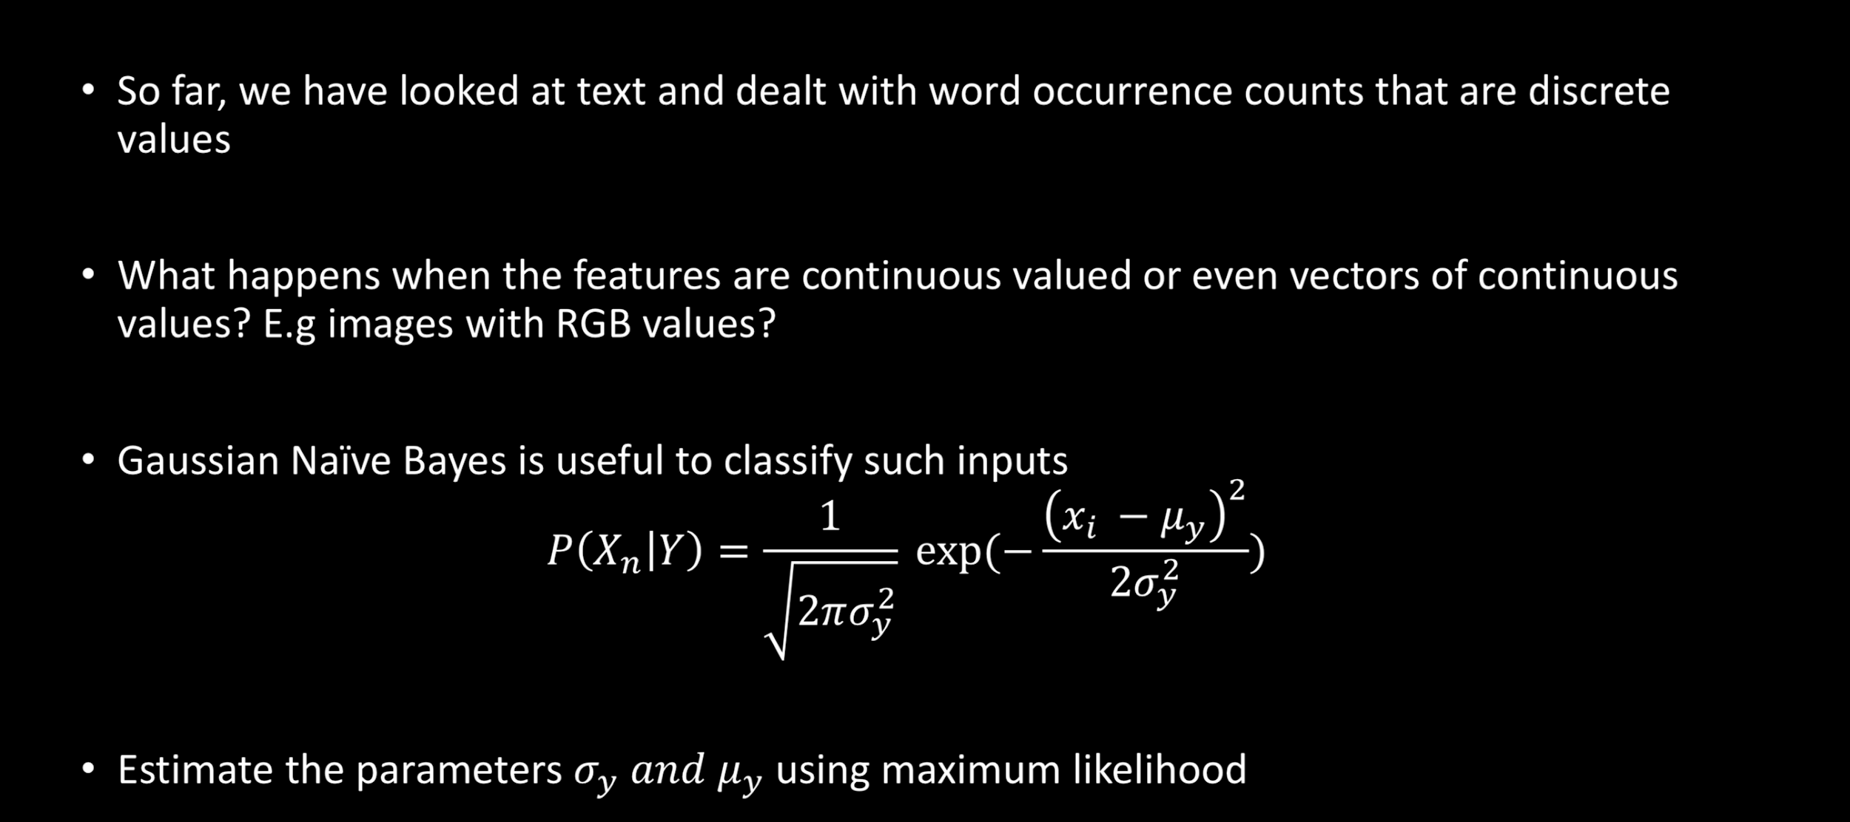
Gaussian Naïve Bayes

Slide 21
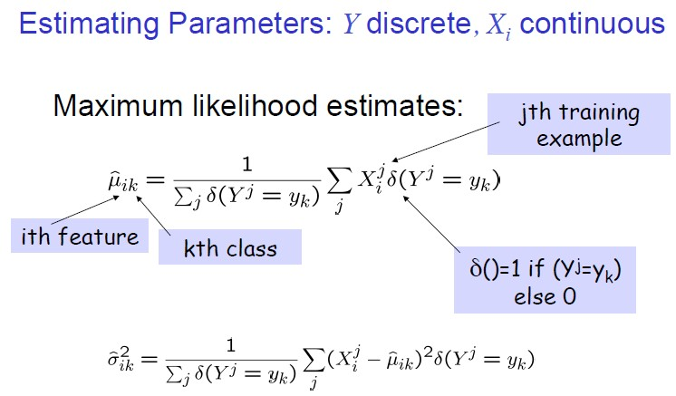
Estimating Parameters (Ref: T Mitchelle)
How many parameters must we estimate for Gaussian Naïve Bayes if Y has k possible values:
𝑋 = 𝑋₁𝑋₂ … 𝑋_{𝑛}

Slide 22
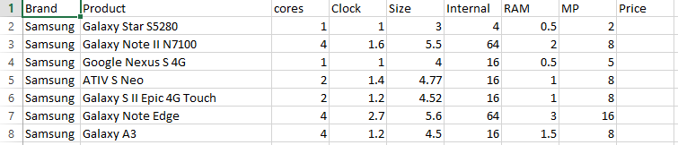
Gaussian Naïve Bayes: Example
Suppose we are required to predict the price range (high_end, mid_range, low_end) of a mobile phone given its specifications.
We observe that some elements in the specification (e.g screen size) are continuous variables.
We can either discretize these elements and use discrete NB classifier or we can directly use a Gaussian NB

Slide 23
Practical Considerations
Probability computations in a joint distribution involve multiplying many terms that are small fractions. This might sometime cause underflow errors. Use log probabilities to avoid this issue
Use the distribution that is natural to the problem on hand
The choice of the distribution to use is your decision. There is no rule that says you should
use Gaussian all the time!
You can discretize continuous variables so that you can use Binarized, Bernoulli or Multinomial discrete Naïve Bayes. But you might lose fidelity due to discretization.
Exercise judgement while choosing the features, you can minimize the data required by removing redundant features

Slide 24
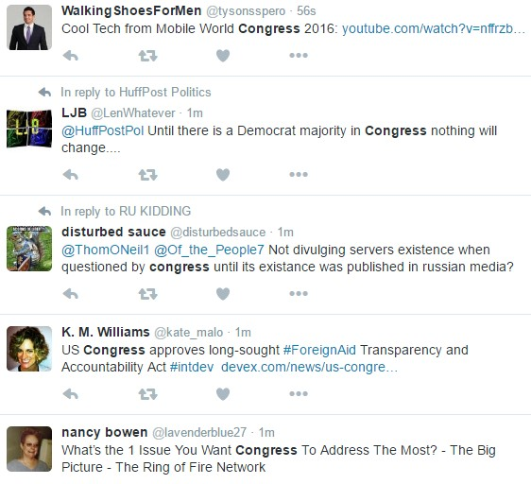
Case Study: Accurate Searching on Twitter
Twitter’s search API allows keywords based search
Suppose we search Twitter with the keyword “congress”, we might end up getting tweets that pertain to Indian National Congress, Mobile World Congress, American Congress, Science Congress and so on.
A narrow search using “exact” search phrase would improve precision but will miss many relevant and interesting tweets
Is there a way to search the Twitter such that we get precise matches without missing interesting and relevant tweets?

Slide 25
Summary
Despite the naïve assumptions, Naïve Bayes classifier is pretty useful. Do not skip it in favour of complex models without evaluating it for your application. You may be in for surprise!
There are many variants of Naïve Bayes Classifier, the common thing about them is that all are based on Bayes theorem and make same assumptions.
Choose binarized model if number of occurrences of a given word do not contribute to the classification process.
If the features are continuous variables, use Gaussian Naïve Bayes or perform
discretization if you get good accuracy

Slide 26
Code Walkthrough

